Slide 1
Lower Bound Theory
Unit 5

Slide 2
Definition
Lower Bound Theory Concept is based upon the calculation of minimum time that is required to execute an algorithm
Lower Bound Theory is used to calculate a minimum number of comparisons required to execute an algorithm

Slide 3
Lower Bound
According to the lower bound theory for lower bound L(n) of an algorithm ,it is not possible to have any algorithm ( for a common problem) whose time complexity is less than L(n) for random input.
Once lower bound is calculated then we can compare it with the actual complexity of the algorithm & if this order is same then we can declare our algorithm as optimal

Slide 4
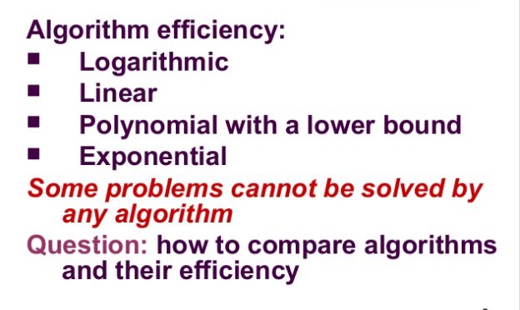

Slide 5
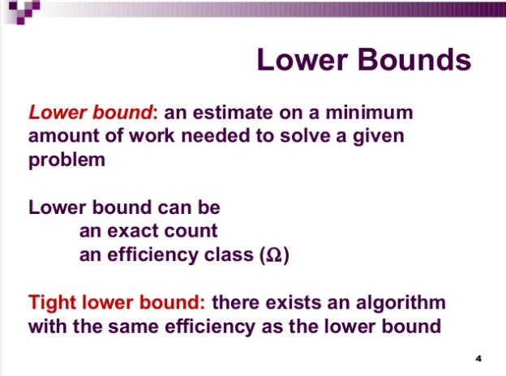

Slide 6
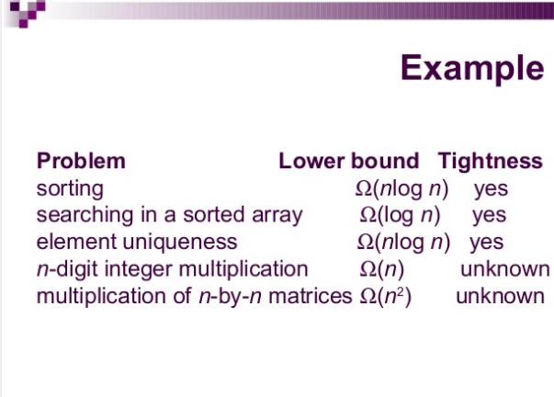

Slide 7
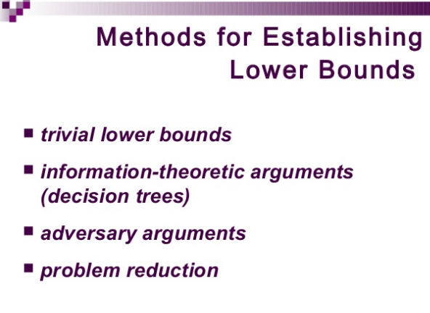
Oracle and adversary Arguments
Oracle and adversary Arguments

Slide 8


Slide 9
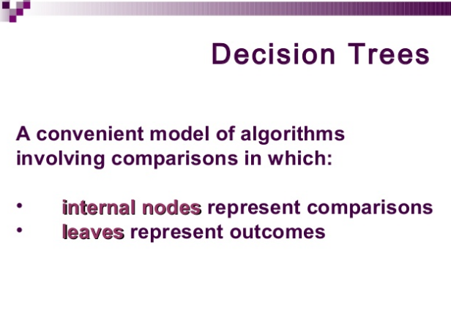

Slide 10
Decision Tree:
A decision tree is a full binary tree that shows the comparisons between elements that are executed by an appropriate sorting algorithm operating on an input of a given size.
Control, data movement, and all other conditions of the algorithm are ignored.
In a decision tree, there will be an array of length n.
So, total leaves will be n! (I.e. total number of comparisons)
If tree height is h, then surely
  n! ≤2^{h} (tree will be binary)

Slide 11
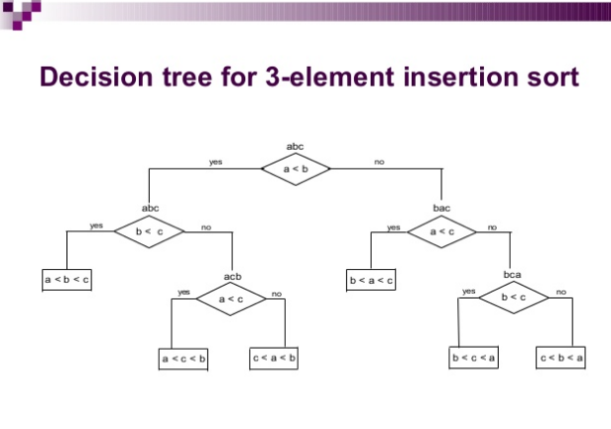

Slide 12
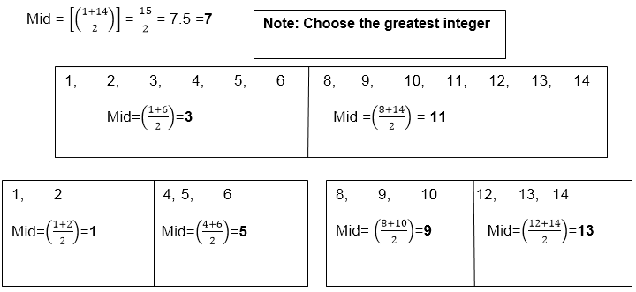
Decision Tree for Binary Search:
Array : 1,2,3,4,5,6,7,8,9,10,11,12,13,14
And the last midpoints are: 2, 4, 6, 8, 10, 12, 14

Slide 13
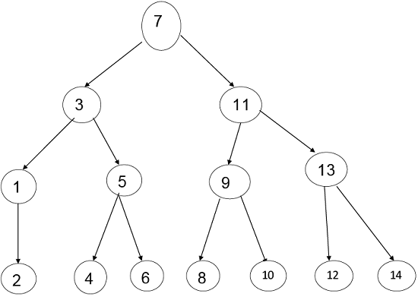
Decision Tree for Binary Search:
According to Mid-Point, the tree will be:

Slide 14

Decision Tree for Binary Search:
Step1: Maximum number of nodes up to k level of the internal node is 2^{k}-1
Step2: Maximum number of internal nodes in the comparisons tree is n!
Step3: From Condition1 & Condition 2 we get
N! ≤ 2^{k}-1 14 < 15 Where N = Nodes
Step4: Now, n+1 ≤ 2^{k}
Here, Internal Nodes will always be less than 2^{k} in the Binary Search.
Step5:
  n+1<= 2^{k}
  Log (n+1) = k log 2
  K>=
  k >=log₂(n+1)
Step6: T (n) = k
Step7: T (n) >=log2(n+1)
Hence, the minimum number of Comparisons to perform a task of the search of n terms using Binary Search is log n

Slide 15
Binary Decision Trees
?
Yes
No
Model algorithms based on successive answers to yes/no questions

Slide 16
?
Yes
No
Answer 1
?
Yes
No
?
Answer 2
Yes
No
Answer 3
Answer 4

Slide 17
Worst case time: depth of tree
A binary tree of depth h has < 2^{h} leaves
A binary tree with N leaves must have depth at least log₂N
This gives a lower bound on the worst case time to find an answer
If the number of possible answers is N, then the algorithm MUST ask at least
log N questions

Slide 18
Lower Bound for Sorting
Number of possible sorted orders = number of all possible permutations of n elements = n!
Hence any comparison-based algorithm for sorting must take at least log n! = O(n log n) time

Slide 19
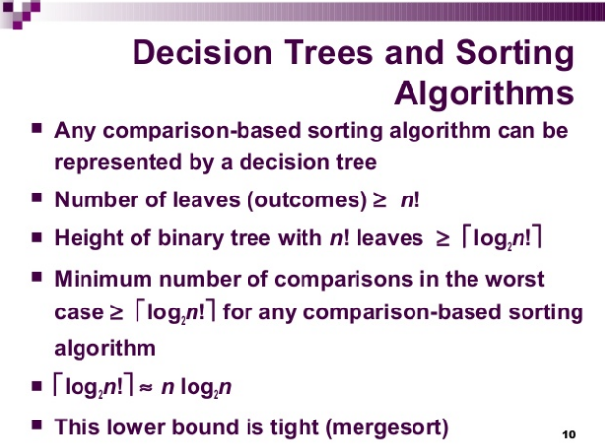

Slide 20
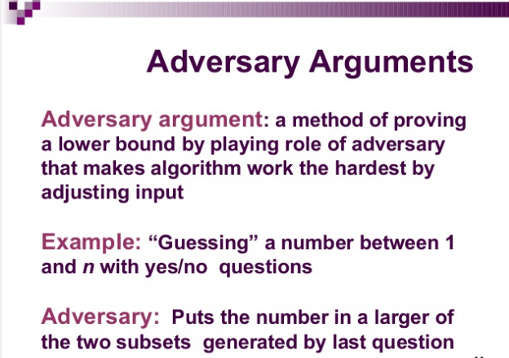

Slide 21
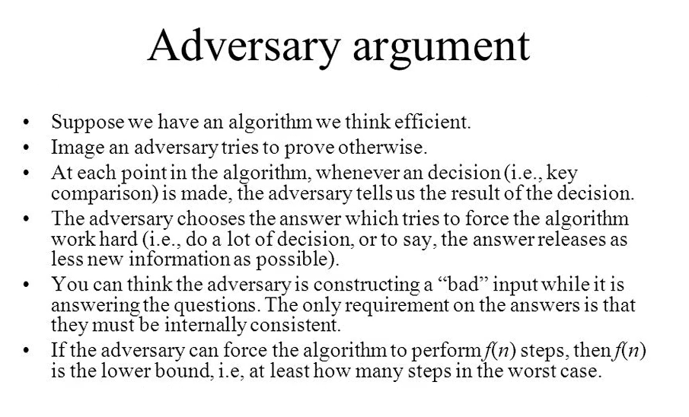

Slide 22
Adversary argument
Adversary argument:
Assume there is a smart algorithm which computes the sum without looking at all the n inputs. An adversary goes and modifies the input not looked at, then run the algorithm again. It should give the same answer (because it didn’t look at the modified input data), but this is not the correct answer.

Slide 23
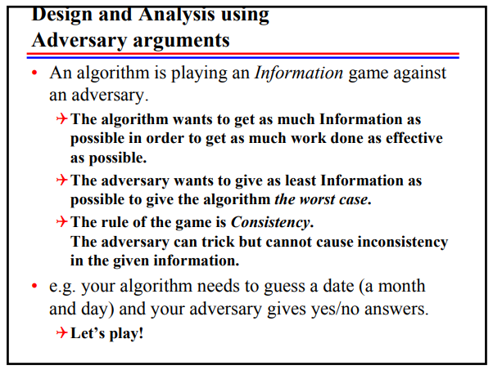
Adversary argument

Slide 24
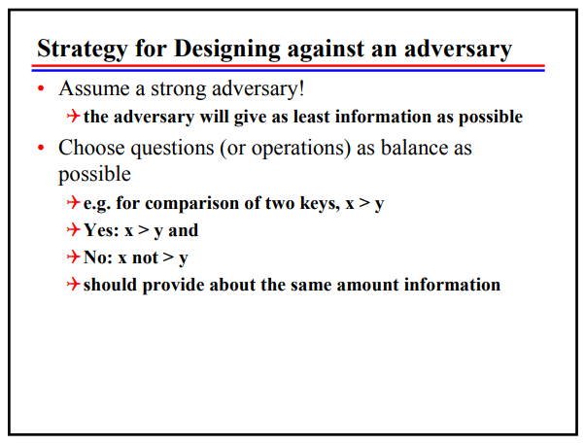
Adversary argument

Slide 25
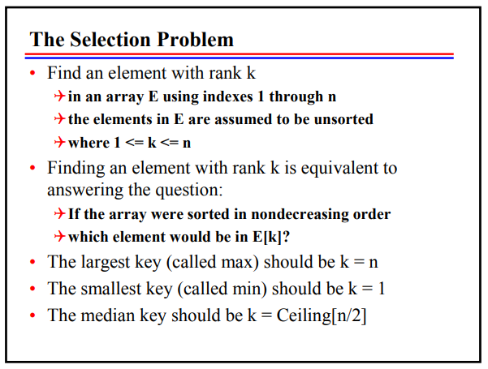
Adversary argument

Slide 26
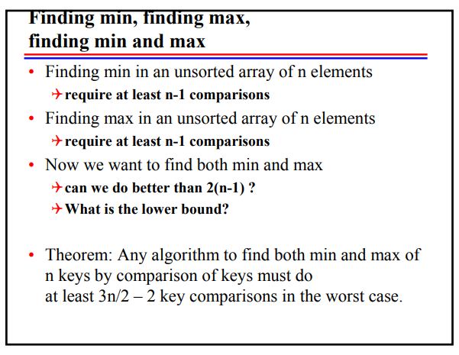
Adversary argument

Slide 27
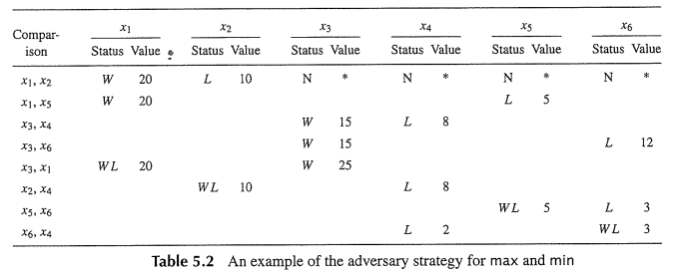
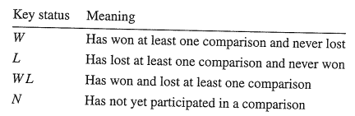
Adversary argument

Slide 28
Adversary Argument for FindMin: need n-1 questions
a1=10
Is a1 < a2?
No.
a2=3
a3=7
Is a3 < a4?
a4=6
No.
Is a4 > a5?
Yes.
a5=5
Minimum is a5!
Wrong! It is a2!

Slide 29
If less than n-1 questions, the graph of comparisons is disconnected
a1
a1
a3
a2
a3
a2
a4
a4
a5
a5
a6
a6
The adversary can re-arrange the data so that the answer is different

Slide 30
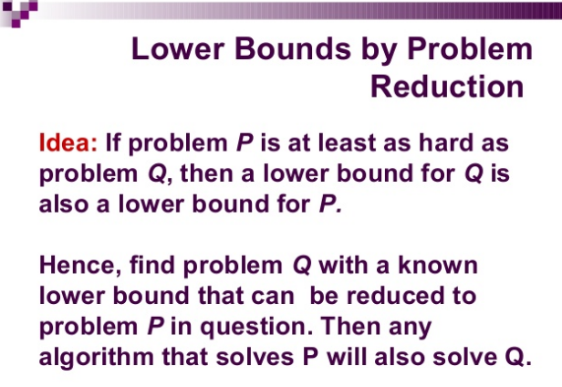

Slide 31
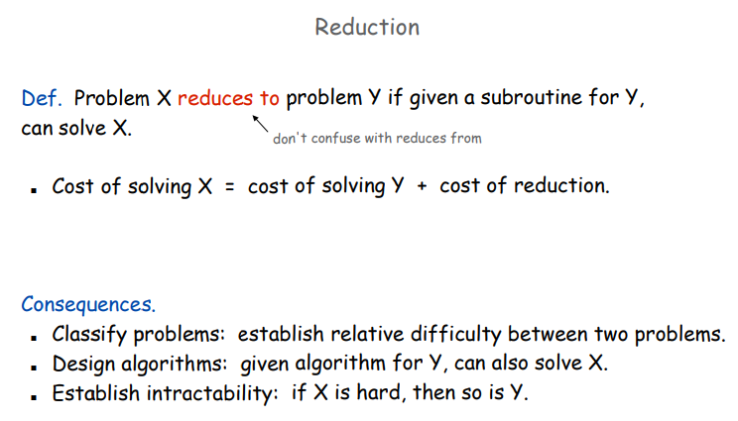

Slide 32
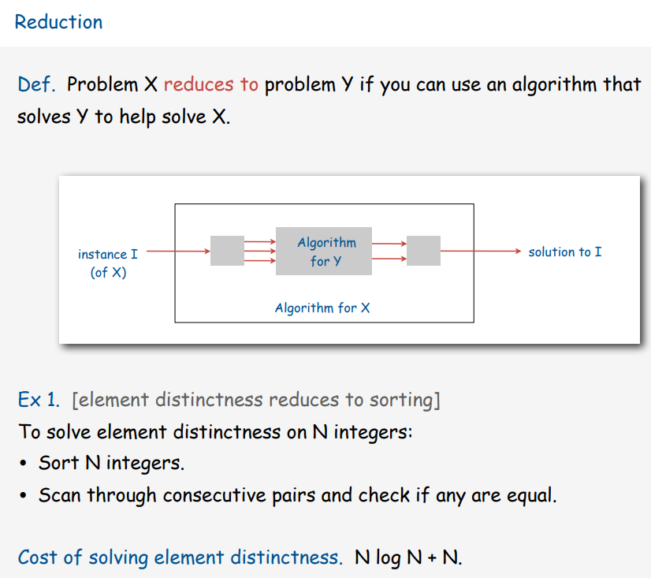

Slide 33
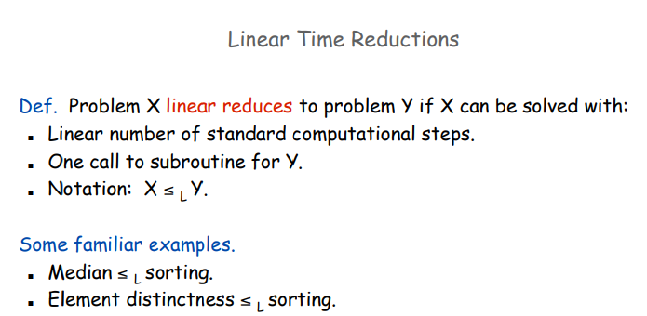

Slide 34
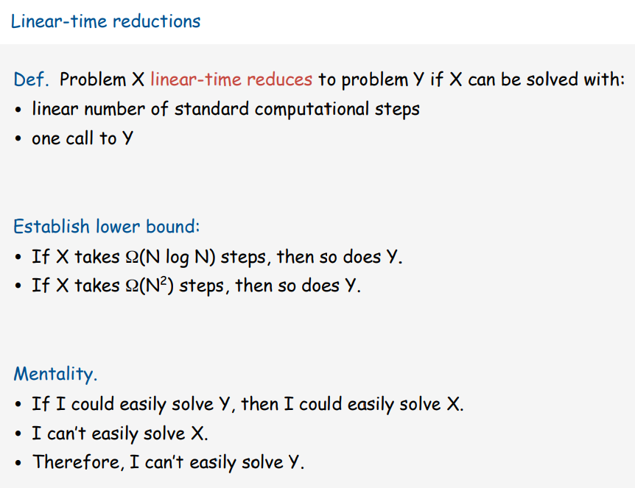

Slide 35
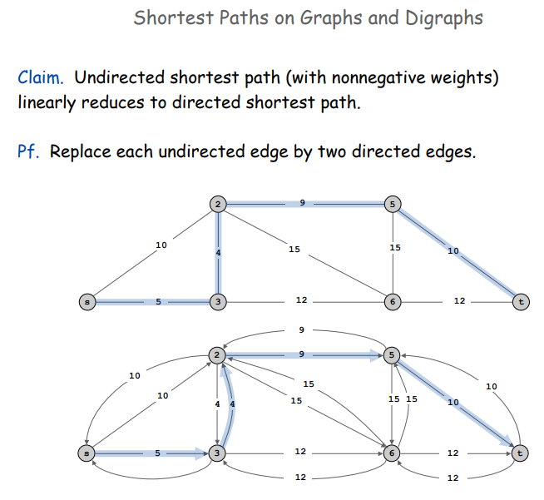

Slide 36
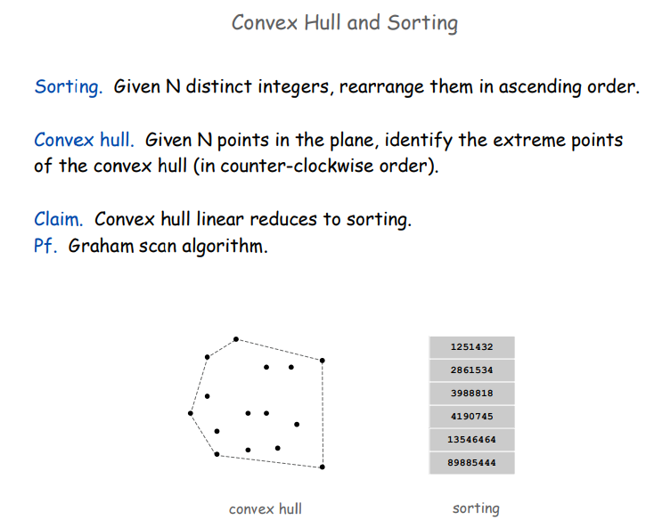

Slide 37
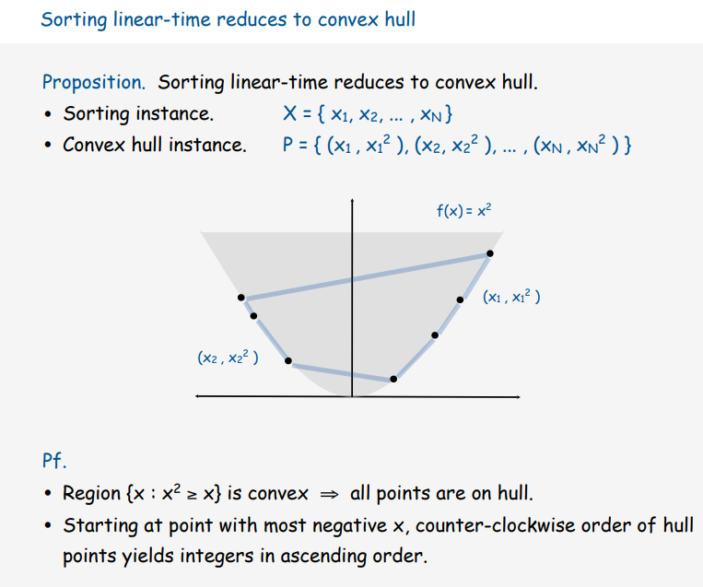

Slide 38
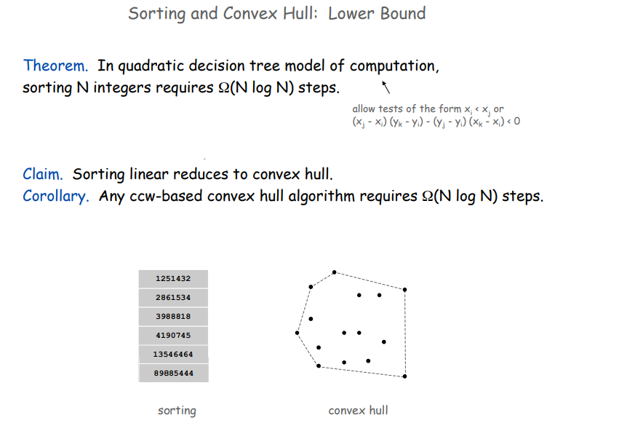

Slide 39
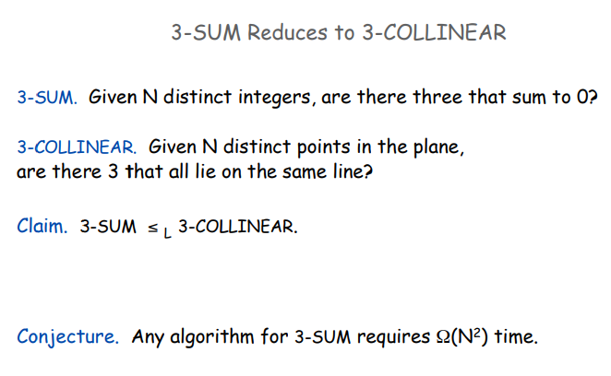

Slide 40
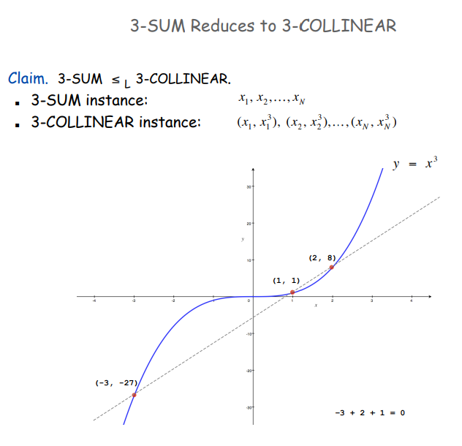

Slide 41
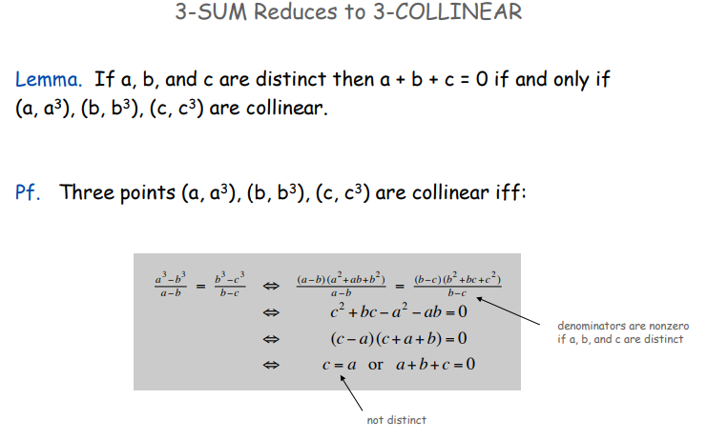

Slide 42
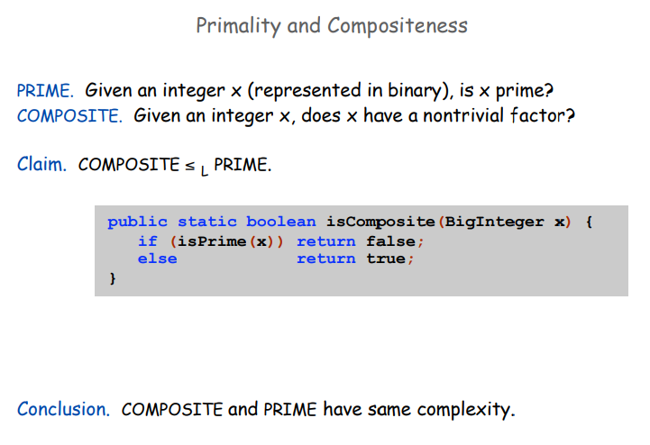

Slide 43
Approximations in DAA
An Approximate Algorithm is a way of approach NP-COMPLETENESS for the optimization problem.
This technique does not guarantee the best solution.
The goal of an approximation algorithm is to come as close as possible to the optimum value in a reasonable amount of time which is at the most polynomial time.
Such algorithms are called approximation algorithm or heuristic algorithm.
For Example, for the traveling salesperson problem, the optimization problem is to find the shortest cycle, and the approximation problem is to find a short cycle.

Slide 44
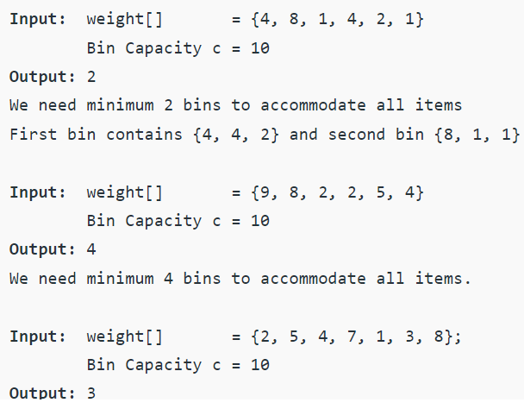
Bin Packing Problem
Given n items of different weights and bins each of capacity c, assign each item to a bin such that number of total used bins is minimized. It may be assumed that all items have weights smaller than bin capacity.
Example:

Slide 45
Lower Bound for Bin Packing Problem
We can always find a lower bound on minimum number of bins required. The lower bound can be given as :
Min no. of bins >= Ceil ((Total Weight) / (Bin Capacity))
lower bound for first example is “ceil(4 + 8 + 1 + 4 + 2 + 1)/10” = 2
lower bound in second example is “ceil(9 + 8 + 2 + 2 + 5 + 4)/10” = 3.

Slide 46
Algorithms for Bin Packing Problem
There are algorithms are for Bin Packing problems where items arrive one at a time (in unknown order), each must be put in a bin, before considering the next item.
Next Fit
First Fit
Best Fit
Worst Fit

Slide 47
Algorithms for Bin Packing Problem
Next Fit Algorithm :
When processing next item, check if it fits in the same bin as the last item. Use a new bin only if it does not.
Example : int item_weight[] = { 2, 5, 4, 7, 1, 3, 8 };
int bin_capacity = 10;
Using Next Fit,
Total Number of bins required in Next Fit : 5

Slide 48
Algorithms for Bin Packing Problem
Next Fit Algorithm :
Next Fit is a simple algorithm. It requires only O(n) time and O(1) extra space to process n items.
Next Fit is 2 approximate, i.e., the number of bins used by this algorithm is bounded by twice of optimal. Consider any two adjacent bins. The sum of items in these two bins must be > c; otherwise, NextFit would have put all the items of second bin into the first. The same holds for all other bins. Thus, at most half the space is wasted, and so Next Fit uses at most 2M bins if M is optimal.

Slide 49
Algorithms for Bin Packing Problem
First Fit Algorithm :
When processing the next item, scan the previous bins in order and place the item in the first bin that fits. Start a new bin only if it does not fit in any of the existing bins.
Example : int item_weight[] = { 2, 5, 4, 7, 1, 3, 8 };
int bin_capacity = 10;
Using First Fit,
Total Number of bins required in First Fit : 4

Slide 50
Algorithms for Bin Packing Problem
2. First Fit Algorithm :
First Fit requires O(n²) time, but First Fit can be implemented in O(n Log n) time using Self-Balancing Binary Search Trees.
If M is the optimal number of bins, then First Fit never uses more than 1.7M bins. So First-Fit is better than Next Fit in terms of upper bound on number of bins.

Slide 51
Algorithms for Bin Packing Problem
Best Fit Algorithm :
The idea is to places the next item in the *tightest* spot. That is, put it in the bin so that the smallest empty space is left.
Example : int item_weight[] = { 2, 5, 4, 7, 1, 3, 8 };
int bin_capacity = 10;
Using Best Fit,
Total Number of bins required in Best Fit : 4

Slide 52
Algorithms for Bin Packing Problem
Best Fit Algorithm :
Best Fit can also be implemented in O(n Log n) time using Self-Balancing Binary Search Trees.
If M is the optimal number of bins, then Best Fit never uses more than 1.7M bins. So Best Fit is same as First Fit and better than Next Fit in terms of upper bound on number of bins.

Slide 53
Algorithms for Bin Packing Problem
Worst Fit Algorithm :
The idea is to places the next item in the least tight spot to even out the bins. That is, put it in the bin so that most empty space is left.
Example : int item_weight[] = { 2, 5, 4, 7, 1, 3, 8 };
int bin_capacity = 10;
Using Best Fit,
Total Number of bins required in Worst Fit : 4

Slide 54
Algorithms for Bin Packing Problem
Worst Fit Algorithm :
Worst Fit can also be implemented in O(n Log n) time using Self-Balancing Binary Search Trees.
If M is the optimal number of bins, then Best Fit never uses more than 2M-2 bins. So Worst Fit is same as Next Fit in terms of upper bound on number of bins.

